Slide 1
GLOBAL INSTITUTE OF TECHNOLGY JAIPUR
Technical Communication
Computer Science
Punit Shukla
Notes:
Global Institute of Technology,Jaipur

Slide 2

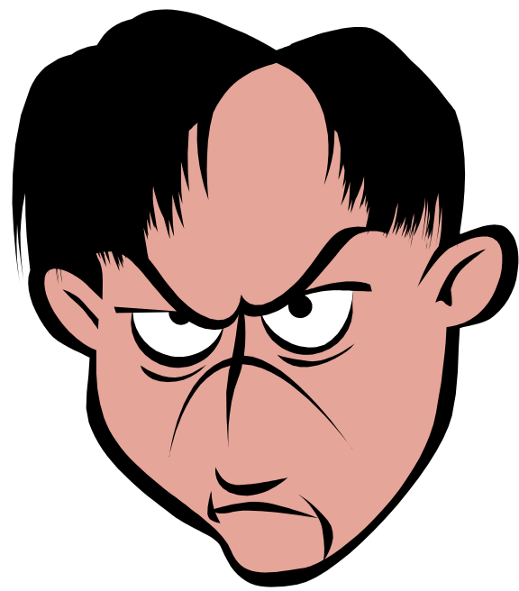
GLOBAL INSTITUTE OF TECHNOLGY JAIPUR
Technical Communication
Computer Science
Verbal Communication:
  Listening
  Speaking
  Reading
  Writing
Non-Verbal Communication:
  Gestures
  Posture
  Facial Expressions
Punit Shukla

Slide 3


GLOBAL INSTITUTE OF TECHNOLGY JAIPUR
Technical Communication
Computer Science
Sender/Encoder
Message
Channel
  Voice
  Written Text
  Visual Images
Receiver/Decoder
Feedback
Punit Shukla

Slide 4

GLOBAL INSTITUTE OF TECHNOLGY JAIPUR
Technical Communication
Computer Science
Hearing v/s Listening: Hearing is a by-default biological process which does not require any attention to the words of the speaker whereas listening is practiced by attention and efforts to concentrate over the words of the speaker.
Effective Listening Skills:
  To Concentrate
  To Avoid Distractions
  To Avoid Interruption
  To clarify Details
  To Give Feedback
Punit Shukla

Slide 5

GLOBAL INSTITUTE OF TECHNOLGY JAIPUR
Technical Communication
Computer Science
Barriers to Listening:
  Interruption
  Prediction of delivered message
  Blocking message due to personal views
  Hearing Disability
  Non-understanding
  Wandering thoughts
Punit Shukla

Slide 6

GLOBAL INSTITUTE OF TECHNOLGY JAIPUR
Technical Communication
Computer Science
Constructive Feedback:
  To be Discussed Privately
  To Address Behavior-Not Person
  To be Specific
  To be Prompt
  To be Positive
  To Suggest Actions to Solve Problem
Punit Shukla

Slide 7

GLOBAL INSTITUTE OF TECHNOLGY JAIPUR
Technical Communication
Computer Science
Destructive Feedback:
  To be Public
  To Address Personal Character
  To be General
  To be Delayed
  To be Negative
  To Offer No Solutions

Slide 8

GLOBAL INSTITUTE OF TECHNOLGY JAIPUR
Technical Communication
Computer Science
Importance of Feedback:
Prevents costly mistakes/accidents;
Provides opportunity for improving work performance;
Routes of Feedback:
Oral/Verbal;
Written Performance Evaluation;
Visual
Punit Shukla

Slide 9

GLOBAL INSTITUTE OF TECHNOLGY JAIPUR
Technical Communication
Computer Science
Positive:
  To make sure you have understood
  To identify the solution
  To take action
Negative:
  Defensiveness
  Disagreement
  Emotional Display
Punit Shukla

Slide 10

GLOBAL INSTITUTE OF TECHNOLGY JAIPUR
Technical Communication
Computer Science
Potential Conflicts v/s Reactions in a Conflict:
Potential conflicts and reactions to the conflicts can both be positive and negative; depends on the psychological thought process of the communicators.
Communication in conflict situations/”I” statements
  I feel ____________________
  When you ________________
  Because _________________
  And, I want _______________
Punit Shukla

Slide 11
GLOBAL INSTITUTE OF TECHNOLGY JAIPUR
Technical Communication
Computer Science
Conflict Resolution Model:
  To Define the Problem
  To Suggest Possible Solutions
  To Compromise
  To Seek Mediation; if not Solution
Punit Shukla

Slide 12

GLOBAL INSTITUTE OF TECHNOLGY JAIPUR
Technical Communication
Computer Science
Self-Awareness
To understand others -
  Empathy
  Tact
Management Strategies
Punit Shukla

Slide 13

GLOBAL INSTITUTE OF TECHNOLGY JAIPUR
Technical Communication
Computer Science
Effective Handling:
  To call an informal meeting;
  To File a Complaint Properly;
  Ineffective Handling:
  Turn to Outside Agencies;
  Allow outsiders involvement
Punit Shukla

Slide 14

GLOBAL INSTITUTE OF TECHNOLGY JAIPUR
Technical Communication
Computer Science
Etiquette
Privacy practices
Gossip
Professionalism
Avoid Comparisons
  Workload
  Salary
Punit Shukla

Slide 15

GLOBAL INSTITUTE OF TECHNOLGY JAIPUR
Technical Communication
Computer Science
To Identify the Problem
To Collect and Analyze Data
To Consider Possible Solutions
To Choose the Best Options
To Implement the Plan
To Observe, Evaluate and Adjust the Plan
Punit Shukla

